Slide 1
Ensemble Learning of Convolutional Neural Network, Support Vector Machine, and Best Linear Unbiased Predictor for Brain Age Prediction: ARAMIS Contribution to the Predictive Analytics Competition 2019 Challenge
Reporter: Ping-Hsueh Ho

Slide 2
Outline
Background & Motivation
Problem Statement
Materials
Hypothesis
Designed Experiment
Proposed Methods
Results and Comparisons
Analysis and Discussion
Conclusion

Slide 3
Background & Motivation
Chronological age is an important risk factor for many conditions
However, it is an imperfect predictor of disease risk or of healthy individuals’ functional capability
Latest research focus on …
→ telomere length, methylation site, brain structure, and function
Especially MRI
Notes:
實際年齡是許多疾病的重要風險因素，例如神經系統疾病(阿爾茨海默氏症和帕金森氏症）、慢性（包括心血管）疾病、癌症或中風等等
然而，它不能完美預測疾病風險或健康個體的功能能力
越來越多的研究領域一直專注於識別年齡的生物學相關性（例如，從端粒長度、甲基化位點、大腦結構和功能）來推導出生物學年齡的測量值
特別是，根據 MRI 圖像估計腦年齡是一個快速擴展的研究領域

Slide 4
Background & Motivation
Predicted age difference (PAD)
Brain age (and PAD) trained on healthy participants may be applied to case-control samples
However…chronological age cannot explain everything
Notes:
PAD→定義為預測年齡和實足年齡之間的差異。PAD與死亡率和功能指標相關
此外，在健康參與者身上訓練的腦齡（和 PAD）可應用於病例對照樣本，在這些樣本中它們已被證明是疾病狀態的非特異性預測因子
但…大腦年齡與疾病、死亡率和功能的相關性超出了實足年齡所能解釋的範圍

Slide 5
Problem Statement

Slide 6
Hypothesis
Try different predictive algorithms [CNNs, SVM, and best linear unbiased predictor (BLUP)]
Try to analyze the effect as below on the brain age prediction ACC
of MRI processing
of number of models combined
of site, sex, and age
Notes:
(i) MRI 處理的效果； (ii) 合併的模型數量； (iii) 地點、性別和年齡對大腦年齡預測準確性的影響

Slide 7
Materials
Average age: 35.8 year
53% female
Unbalanced

Slide 8
Materials – Image Features
Gray Matter and White Matter Maps – PAC team
Non-linear registered to the MNI152 space
Segmentation: SPM12 + DARTEL
Smooth processing: 4-mm kernel
Notes:
說到registration,就必須要首先介紹一下模板.由於人腦存在個體差異, 掃描時候的圖像在空間中的坐標也不同, 研究時必須要首先消除個體差異,統一坐標, 也就是需要將被試人員的大腦全部”訂正/配準”到標準模板上, 這樣後續才能進行統計分析.目前國際上最廣泛使用的標準模板是MNI152. MNI是加拿大的蒙特利爾神經科學研究中心 “Montreal Neurosciences Institute”的縮寫. MNI152采用了152個健康人的152 3D T1數據加權平均得到. 根據平均算法不同, 分為線性linear和非線性nonlinear兩種

Slide 9
Materials – Image Features
Surface-Based Processing of Gray Matter – For raw T1w image
Extract vertex-wise measurements of cortical thickness and surface area: FreeSurfer 6.0
Extract a vertex-wise characterization of seven subcortical nuclei thickness and surface: ENIGMA-shape protocol
Our processing resulted in ~650,000 gray matter measurements per individual
Processing failed: 3.4% for training sample / 3.2% for PAC test set
Notes:
T1w image:不同類型醫療影像能夠提供特定之診斷訊息，如：MRI中T1權重影像(T1-weighted image, T1w image)提供高空間解析度之組織對比結構影像，可觀察到組織器官之間的空間資訊
使用FreeSurfer 6.0 處理原始 T1w 圖像以提取皮質厚度和表面積的頂點測量值
使用 ENIGMA-shape 協議進一步提取七個皮層下核厚度和表面的頂點特徵
與其他基於表面的處理相比，這些處理最大化了與年齡的關聯
training sample中有3.4%處理失敗，而testing dataset中也有3.2%處理失敗，原因是lower image quality

Slide 10
Designed Experiment

Slide 11
Proposed Methods – BLUP
Minimizing the mean square error within the class of linear unbiased predictors
Computationally efficient – use estimated variance–covariance matrix between the features
Use OSCA[35] to compute BLUP score
Notes:
BLUP score有個理想特性是，會minimize類別的linear unbiased predictor的MSE(mean square error)，使得在遺傳學方面的預測有不錯的成績，且BLUP的計算是很有效率的(因為不需要hyperparameter estimation)，BLUP 使用特徵（此處為頂點）之間的estimated variance–covariance matrix來導出特徵與每個頂點之間的joint marginal associations

Slide 12
Proposed Methods – BLUP
BLUP-mean: scores using the mean and SD calculated from each site of the discovery sample
BLUP-quantiles: applied quantile-based scaling to address non-normal distribution

Slide 13
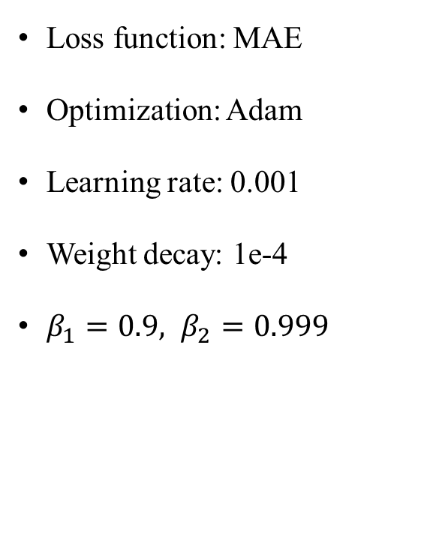
Proposed Methods – 6-Layer CNN
Loss function: MAE
Optimization: Adam
Learning rate: 0.001
Weight decay: 1e-4
$β_{1}=0.9, β_{2}=0.999$

Slide 14
Proposed Methods – Special 6-Layer CNN
This model is the combination of two 6-layer CNNs with the architecture described in the previous section
First CNN: for whole dataset
Second CNN: only older than 40
Notes:
Special CNN model是由兩個6-Layers CNN的結構組成(每一個6-Layer CNN架構都是如前一節所示)，第一個是train全部的dataset，而第二個是只train 40歲以上的data，所以年輕的data prediction是只有第一個CNN參與predict，若是較老的data prediction，則由整個model給出最後的年齡

Slide 15
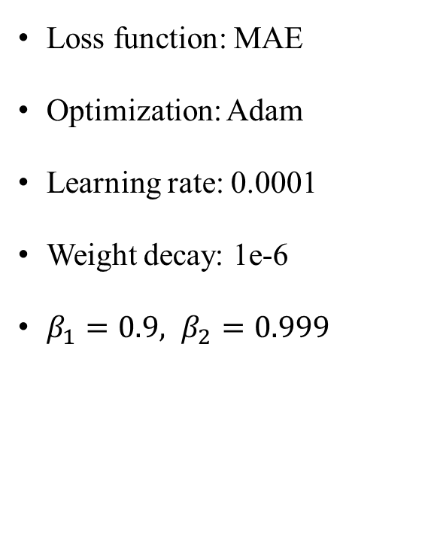
Proposed Methods – ResNet
Loss function: MAE
Optimization: Adam
Learning rate: 0.0001
Weight decay: 1e-6
$β_{1}=0.9, β_{2}=0.999$
Notes:
整體結構：該模型是一個 3D CNN，由五個residual block組成，每個residual block後跟一個kernel size為 3 × 3 × 3 且step size為 2 × 2 × 2 的max-pooling layer，然後是一個flatten layer和一個fully connected block。
細部結構：每個residual block都是重複兩次的層的組合。每layer由kernel size為 3×3×3、step size 為 1×1×1 的 3D 卷積層、batch normalization layer和exponential linear unit (ELU) activation function組成，在最後一個activation function之前添加一個跳過連接

Slide 16
Proposed Methods – Inception V1
Loss function: MAE
Optimization: Adam
Learning rate: 0.0001
Batch size: 8 images
Notes:
最後的 softmax layer被移除，留下一個fully connected layer作為最後一層，從而確保regression task而不是classified task(很明確，因為是要預測一個明確的數值)
為了防止梯度消失所以用auxiliary layer處理梯度消失的問題

Slide 17
Proposed Methods – Overall
Train/Test: 2107/533(8:2)
5-Fold CV for SVM

Slide 18
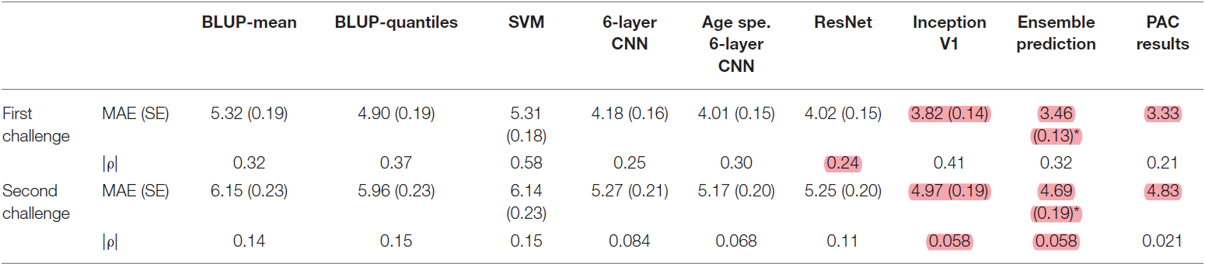

Results and Comparisons – Validation set
Mean absolute error (standard error) / Spearman correlation coefficient ρ
$SE=SD/\sqrt{N}$ reflects the uncertainty around the MAE estimate

Slide 19
Analysis and Discussion

Slide 20
Conclusion
Significance of the study

Slide 21
Q&A
Thank you

